Slide 1


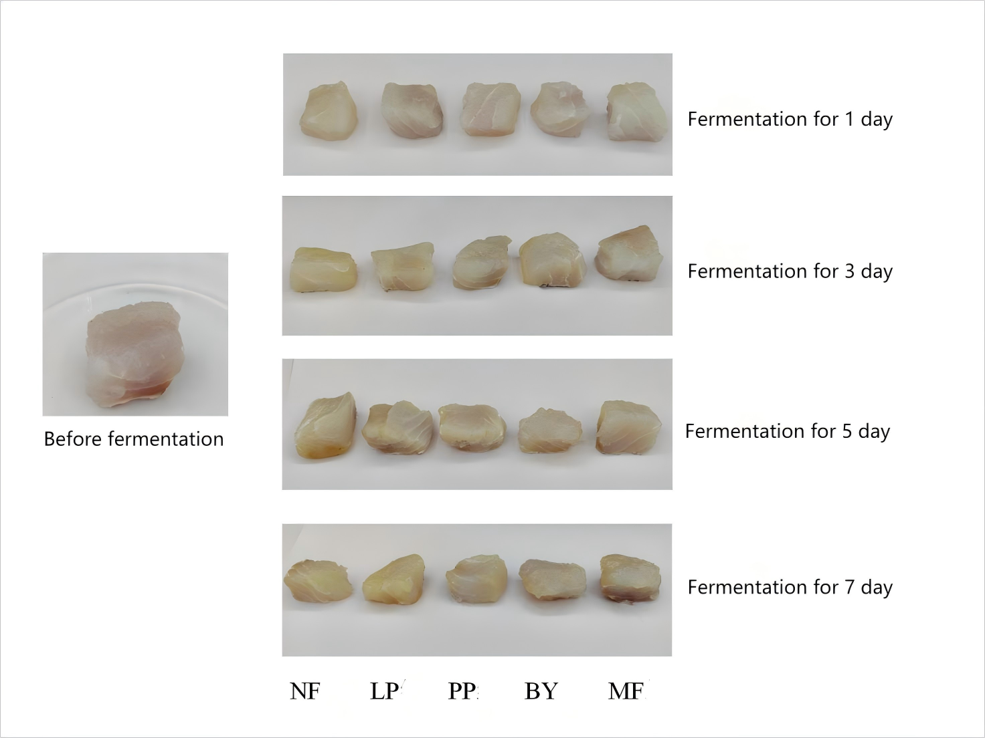
FSMILE 2025
Effect of microbial starter culture on quality and flavor of low-salt red snapper
October 04-07, 2025
@Morioka & ZOOM Cloud
Yiduo Wu¹, Yaqin Hu ¹*
1.College of Food Science and Engineering, Yazhou Bay Innovation Institute, Hainan Tropical Ocean University, Marine Food Engineering Technology Research Center of Hainan Province, Collaborative Innovation Center of Marine Food Deep Processing, Hainan Key Laboratory of Herpetological Research, Sanya 572022, China
International Symposium on Food Communications and Sustainable Agri-Aqua Food Systems
Connecting Primary Industries, Academia, and Society through the SDGs
Contact Information:
1264198042@qq..com.
Introduction
Red-snapper (Lutjanus erythropterus) is also known as red fish, is a characteristic economic fish in the west coast of Hainan. Its processing methods are mainly dry and pickled, with single taste and flavor and lack of freshness.
Results
Conclusions
(1) Compared with the natural fermentation, different microbial starter cultures could play a role in the fermentation process of red fish, which could significantly reduce the water content, AW and pH, and increase the TA content of fish meat.
(2) Microbial starter culture significantly improved the texture, hardness and chewiness of red fish, brighted the color of red fish, increased AAN content and TBARS, and inhibited the formation of TVB-N.
(3) Microbial starter cultures contribute to the production of flavor substances in the fermentation process, which can not only ensure the flavor of low-salt fermented fish, but also inhibit the production of adverse flavor.
A
B
The water content of red fish inoculated with starter culture was lower than that of NF group, and the difference of water content between groups inoculated with different microbial starter culture and NF group was different.
Inoculation and fermentation effectively reduced water activity of redfish.
With the extension of fermentation time, the pH value of naturally fermented and inoculated red fish decreased significantly (p < 0.05).
The change trend of TA content was opposite to that of pH, and TA content in each fermentation group gradually increased with the decrease of pH.
A
AIM
In order to better develop and use red fish, improve the quality of red fish products, innovative flavor.
B
Method
Low-salt red fish pieces were prepared
The pickled low-salt redfish pieces were rinsed with water and dried in the oven at 30 ° C for 30 min.
Activation of microbial starter culture
The bacterial solution was 100 cfu /g and activated with warm water at 37 ° C.
Red fish fermentation
Redfish were inoculated with 5% microbial starter and then incubated at 30 ° C for 7 days.
Quality determination of fermented red fish
Water content, AW, pH, total acid, color, texture, amino acid nitrogen, TBARS and TVB-N were used to comprehensively evaluate the quality changes of red fish during fermentation.
Determination of flavor of fermented red fish
The effects of different microbial starter cultures on the flavor of low-salt redfish were analyzed by electronic nose.
C
D
Acknowledgements
This work was financially supported by Scientific Research Foundation of Hainan Tropical Ocean University (RHDRC202117 and RHDRC202307)
Figure 3. Flavor changes in low-salt redfish during fermentation
(A: principal component analysis chart; B: radar chart)
The flavor of fermented fish in the NF group was significantly different from that in the bacterially infected group, which could be clearly distinguished.
Figure 1. Effects of Microbial Starter Cultures on Basic Indicators of Low-salt Redfish
(A: Water content and AW; B: pH; C: TA; D: Picture)
References
Gao P, Zhang X, Zhang Z, et al. Application of Wickerhamomyces anomalus and Pichia fermentans to improve the aroma of fermented sour fish . LWT-Food Science & Technology, 2024, 192: 115725.
Xu Y, Li L, Xia W, et al. The role of microbes in free fatty acids release and oxidation in fermented fish paste . LWT-Food Science & Technology, 2018, 101: 323-330.
Wei P, Zhu K, Cao J, et al. The inhibition mechanism of the texture deterioration of tilapia fillets during partial freezing after treatment with polyphenols. Food Chemistry, 2021, 335: 127647.
Zang J, Xu Y, Xia W, et al. Quality functionality and microbiology of fermented fish: A review [J]. Critical Reviews in Food Science and Nutrition, 2020, 60(7): 1228-1242.
A
B
C
The AAN, TBARS value and TVB-N of red fish fermented by different microorganisms showed an increasing trend.
The changes of AAN , TBARS value and TVB-N of red fish fermented by different microorganisms were different.
Figure 2. Effect of Microbial Starter Cultures on Oxidative Indices of Low-Salt Redfish
(A: ANN; B: TBARS; C: TVB-N).

